Slide 1

24 SEVEN EXPANSION PLAN
Advanced Topics in Information Systems
*logo was generated with open AI

Slide 2
Table of Contents
01
INTRODUCTION & PROBLEM DESCRIPTION
02
EXTERNAL DATA COLLECTION & CLEANING
03
USE CASE 1 : Optimal Location
04
USE CASE 2 : Sales Trends
05
USE CASE 3 : Forecasting Sales Demand
06
BUSINESS IMPLICATIONS

Slide 3
SECTION 1 : INTRODUCTION & PROBLEM DESCRIPTION

Slide 4
Problem Description
Transformation: "24Seven" evolved from a local shop to a 24-hour convenience store chain with 10 Canadian locations.
Expansion Plan: Leadership aims to open the 11th store strategically to enhance accessibility and reliability for customers.
Strategic Need: Locating the new store strategically is crucial for customer satisfaction and business success.
Analytical Solution: An interactive dashboard utilizing open-source datasets will help in decision-making and forecasting sales/demand for the new store.
4
Notes:
Angel

Slide 5
SECTION 2 : EXTERNAL DATA COLLECTION & CLEANING

Slide 6
External Data
Dataset 1: Population by Postal Code
Source: https://www150.statcan.gc.ca/t1/tbl1/en/cv.action?pid=9810001901
Description: Provides population counts by postal code areas, aiding in understanding potential customer base sizes for location optimization.
Dataset 2: Population by Gender and Province
Source: https://www150.statcan.gc.ca/t1/tbl1/en/cv.action?pid=1710000501
Description: Offers population distribution data by gender within provinces, facilitating demographic segmentation and targeted marketing efforts.
Dataset 3: Population by Age and Province
Source: https://www150.statcan.gc.ca/t1/tbl1/en/cv.action?pid=1710000501
Description: Contains data on population distribution by age groups across provinces, assisting in demographic targeting and predicting demand for age-specific products.
6
Notes:
Angel

Slide 7
External Data
Dataset 4: Couche-Tard Canada Locations
Source: https://www.couche-tard.com/list-canada-stores?lang=en
Description: Lists the locations of Couche-Tard convenience stores throughout Canada, providing insights into the competitive landscape and market saturation levels.
Dataset 5: Canadian University Enrollment
Source: https://univcan.ca/universities/facts-and-stats/enrolment-by-university/
Description: Enrollment figures for Canadian universities, aiding in understanding potential markets in areas with high student populations.
Dataset 6: Median Household Income by City
Source: https://www150.statcan.gc.ca/t1/tbl1/en/cv.action?pid=9810005501
Description: Provides median household income levels by city, enabling socio-economic segmentation and predicting spending patterns.
7
Notes:
Angel

Slide 8
Data Cleaning
Addressed inconsistencies, missing values, and formatting errors to ensure data accuracy and consistency. (Example - blank spaces before postal codes in store location)
Standardized data formats (city, province, postal code, etc.) for better use in maps
Inconsistencies in province and city names (Example - London Ontario was showing up on the map as London UK), had to add a column for country
Applied transformation techniques such as removing duplicates, correcting errors, and removing n/a’s
8
Notes:
Angel

Slide 9
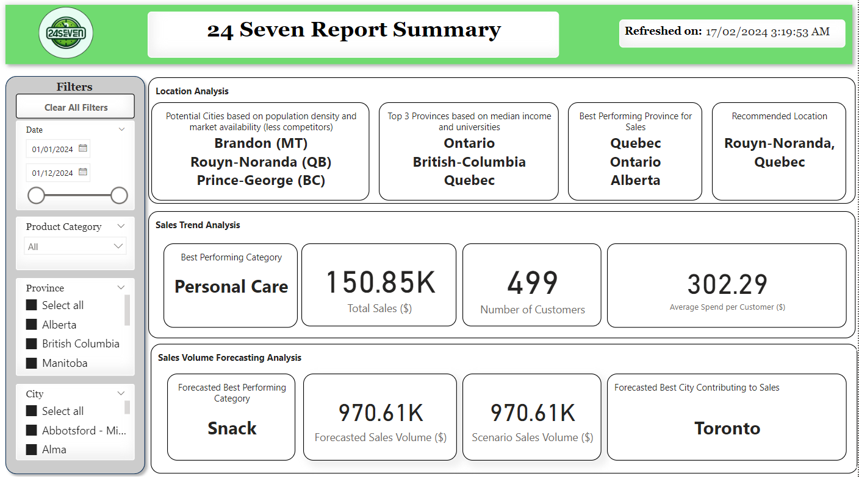
Summary Dashboard Extract
9
Notes:
Dhevin

Slide 10
SECTION 3 : USE CASE 1 - OPTIMAL LOCATION

Slide 11
Description & KPI’s
Description: The Optimal Location Dashboard is designed to guide 24 Seven in identifying strategic locations for expansion by analyzing multiple data points, including current store locations, median household income, university presence, and competition density.
KPI 1: Existing Store Distribution
KPI 2: Provincial Economic and Educational Indicators
KPI 3: Population Density Versus Competition
11
Notes:
Dhevin

Slide 12
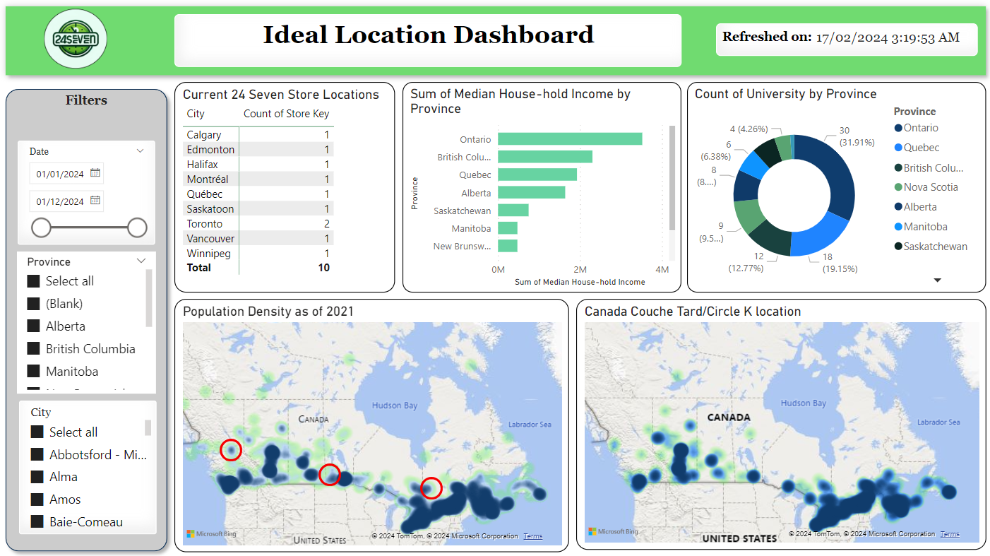
Dashboard Extract
12
Notes:
Dhevin

Slide 13
SECTION 4 : USE CASE 2 - SALES TRENDS

Slide 14
Description & KPI’s
Description: The Sales Trend Analysis Dashboard serves as a focal point for understanding 24 Seven's performance over time. It combines historical sales data, customer demographics, and regional sales information to provide a better view of the company's sales dynamics.
KPI 1: Sales Performance Over Time
KPI 2: Customer Engagement by Product Category
KPI 3: Demographic Sales Analysis
KPI 4: Regional Sales Distribution
14
Notes:
Dhevin

Slide 15
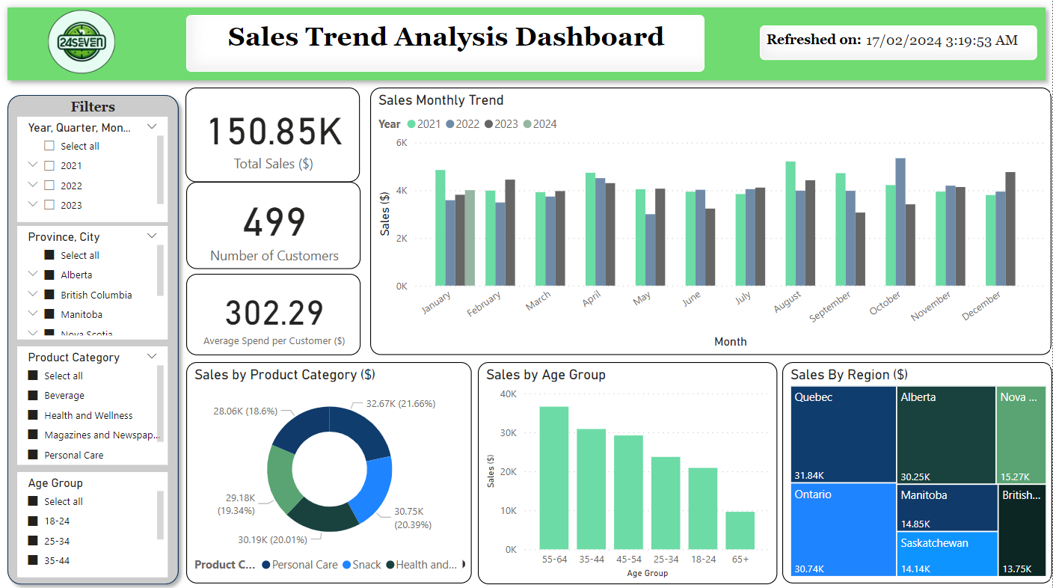
Dashboard Extract
15
Notes:
Dhevin

Slide 16
SECTION 5 : USE CASE 3 - FORECASTING SALES

Slide 17
Description & KPI’s
Description: This dashboard is a tool developed to assist 24 Seven in forecasting sales demand and conducting scenario analysis for potential new store openings across Canada. It integrates advanced predictive analytics to estimate demand and allows stakeholders to interactively model various 'what-if' scenarios by adjusting discount rates and demand changes.
KPI 1: Forecasted Sales Volume
KPI 2: Scenario Analysis Impact
KPI 3: Cumulative Sales Volume Comparison
17
Notes:
Dhevin

Slide 18
Forecasting Algorithm
Model Selection: Utilized multiple regression algorithms including linear regression, decision tree regressor, random forest regressor, and gradient boosting regressor.
Model Evaluation: Evaluated models based on mean squared error scores, selecting the gradient boosting regressor for its superior performance.
Feature Importance: Utilized random forest feature importance to identify and eliminate less impactful features, enhancing the gradient boosting model's accuracy.
Forecast Generation: Leveraged the gradient boosting regressor to forecast monthly sales volumes for each city by category in the year 2024.
Scenario Simulation: Enabled scenario analysis by adjusting variables such as demand and discount percentages, providing stakeholders with insights into potential sales variations.
18
Notes:
Dhevin

Slide 19
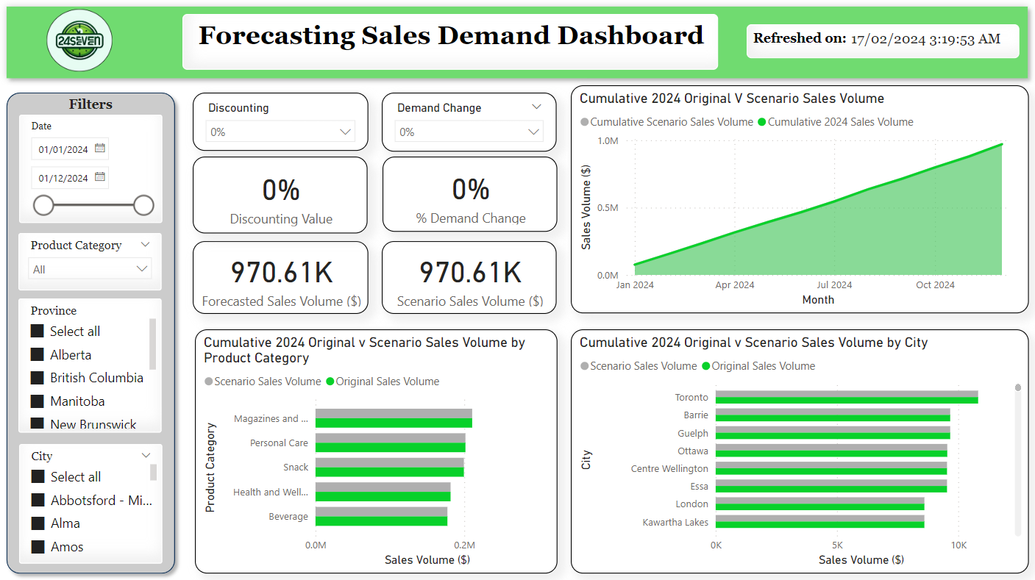
Dashboard - Scenario 1
19
Notes:
Dhevin

Slide 20

Dashboard - Scenario 2
20
Notes:
Dhevin

Slide 21
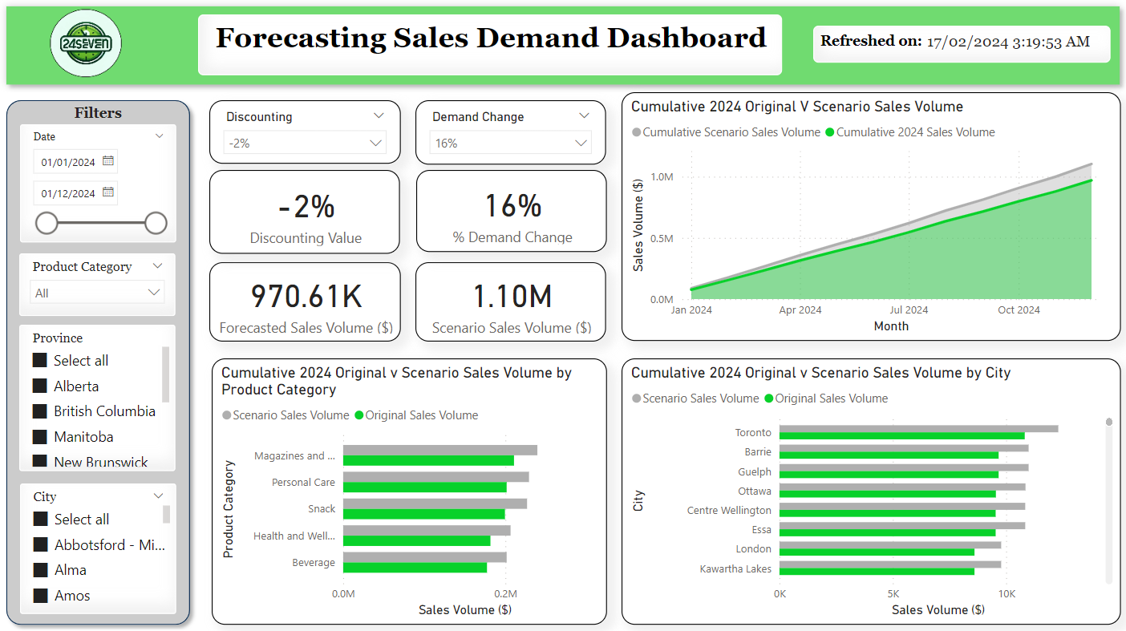
Dashboard - Scenario 3
21
Notes:
Dhevin

Slide 22
SECTION 6 : BUSINESS IMPLICATIONS

Slide 23
Dashboard Insights
Ideal location is Rouyn-Noranda based on high population, low competition and high income, high universities and high sales in QB
High median household incomes in specific provinces (ON, BC, QB) correlate with higher sales volumes (ON, QB, AL), suggesting a link between regional economic health and store performance.
The customer demographic data, such as age distribution, suggests that certain age groups (55-64) are key contributors to sales, providing a target for focused marketing and product placement.
Seasonal trends in sales are evident, with certain months (December, August) displaying peaks, which could guide inventory management and promotional activities.
23
Notes:
Dhevin

Slide 24
Business Implications
The insights can inform strategic decisions about where to open new stores, focusing on high-growth potential areas with affluent populations and less market saturation.
Tailored marketing campaigns can be developed to target the most responsive customer demographics, potentially increasing market share in key segments.
Data-driven inventory planning can help optimize stock levels to meet predicted demand, reducing the risk of overstocking or stockouts.
Scenario planning capabilities enable the company to prepare for various market conditions, ensuring agility and resilience in sales strategies.
24
Notes:
Dhevin

Slide 25
THANK YOU
IF YOU HAVE ANY QUESTIONS, FEEL FREE TO ASK!

Slide 26

SECTION 7 : RESOURCES

Slide 27
Resources
Alimentation Couche-Tard. (n.d.). Find a store. Retrieved February 12, 2024, from https://www.couche-tard.com/list-canada-stores?lang=en
Environment and Climate Change Canada. (n.d.). Canadian Climate Normals. Retrieved February 12, 2024, from https://climate.weather.gc.ca/climate_normals/index_e.html
Statistics Canada. (n.d.). Population estimates on July 1st, by age and sex. Retrieved February 12, 2024, from https://www150.statcan.gc.ca/t1/tbl1/en/cv.action?pid=1710000501
Statistics Canada. (n.d.). Population and dwelling count highlight tables, 2016 Census. Retrieved February 12, 2024, from https://www150.statcan.gc.ca/t1/tbl1/en/cv.action?pid=9810013801
Statistics Canada. (n.d.). Table 111-0009 - Family characteristics, median income by family type, annual. Retrieved February 12, 2024, from https://www150.statcan.gc.ca/t1/tbl1/en/cv.action?pid=9810005501
Statistics Canada. (n.d.). Population estimates on July 1st, by age and sex. Retrieved February 12, 2024, from https://www150.statcan.gc.ca/t1/tbl1/en/cv.action?pid=1710000501
Universities Canada. (n.d.). Enrolment by university. Retrieved February 12, 2024, from https://univcan.ca/universities/facts-and-stats/enrolment-by-university/
27

